Slide 1

PYCAMP 2.0
Day 2 (DATA STRUCTURES IN PYTHON)

Slide 2

Agenda for Day 2
1
7
Python Strings
Exception Handling
2
8
Lists
Functions
3
8
Tuples
Python Calculator
4
Sets
5
Dictionaries
6
Loops

Slide 3
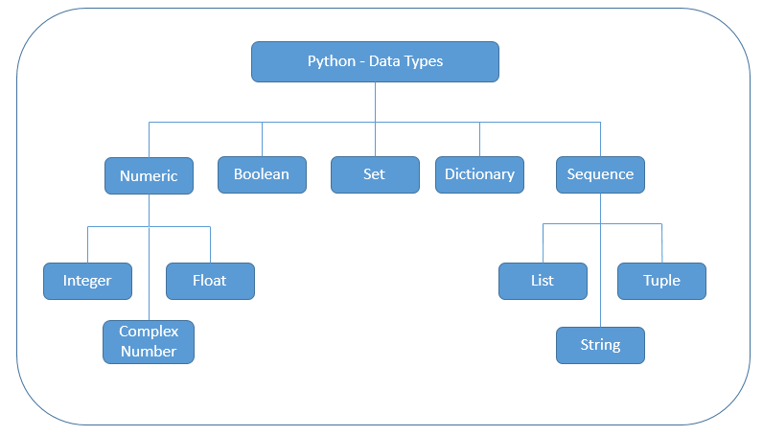
Python Data Types

Slide 4
Strings
String is a sequence of characters
String may contain alphabets, numbers and special characters
Strings are usually enclosed within a single or double quotes
Eg: str1 = "Hello World“
Hello WORLD !!
Python mainly consist of 3 inbuilt string functions
len() : - find out the length of characters in string
min() : - smallest value in a string based on values
max() : - value in a string based on values

Slide 5

Lists
List is an object that holds a collection of objects ; it represents a sequence of data
A list can hold any Python object. A list is non-homogeneous i.e., the elements of a list do not all have to be of same type
Use [ ] to indicate the start and end of the list and separate the items by commas
Eg: - list1 = [1,"Test",True]

Slide 6
Tuples
A tuple is a collection of different data types which are ordered and unchangeable (immutable).
Once a tuple is created, we cannot change its values. We cannot use add, insert, remove methods in a tuple because it is not modifiable (mutable).
Unlike list, tuple has few methods.
Use ( ) to indicate the start and end of the list and separate the items by commas
(“LFC", 1)
Eg: - tup = (2,False,"LFC")

Slide 7

Dictionaries (1/2)
Dictionary: Mutable container type, can store any number of Python objects
Dictionaries consist of pairs (called items) of keys and their corresponding values
Each key is separated from its value by colon :
The items are separated by commas and the whole thing is enclosed in curly braces { }
Keys are unique within a dictionary while values may not be .

Slide 8
Dictionaries (2/2)
Item 1
mobile = { 1 : 'Apple', 2 : 'Samsung', 3 : 'OnePlus' }
Items separated by commas
Dictionary name
Key
Separation between keys & values
Value

Slide 9
Sets
Set is a collection of unordered and unindexed distinct elements
In python set is used to store unique items, and it is possible to find the union, intersection, difference, symmetric difference, subset, super set and disjoint set among sets.
A set is an unordered collection of items. Every set element is unique (no duplicates) and must be immutable (cannot be changed)
However, a set itself is mutable. We can add or remove items from it.
Eg: c= {10,20, 'text' , 10 ,30 }

Slide 10
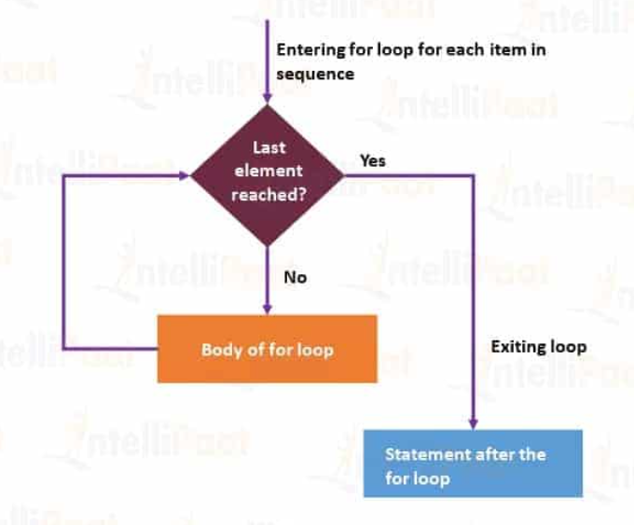
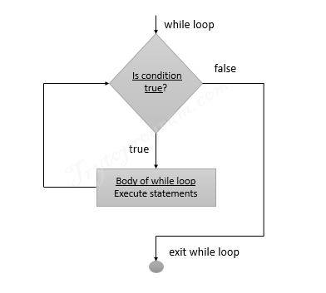

Loops

Slide 11

Exception Handling
Python has many built-in exceptions that are raised when your program encounters an error
When these exceptions occur, the Python interpreter stops the current process and passes it to the calling process until it is handled. If not handled, the program will crash.
To avoid crashing of our program we use try and except to handle the error messages
Try : The try block is used to check some code for errors i.e the code inside the try block will execute when there is no error in the program.
Except : Whereas the code inside the except block will execute whenever the program encounters some error in the preceding try block.
However, a set itself is mutable. We can add or remove items from it.
Error Found

Slide 12
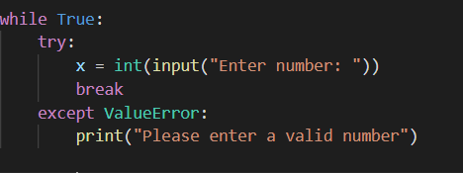
Exception Handling (Errors)
The common errors to catch
ZeroDivisionError (no divided by 0)
ValueError (wrong value used)
TypeError (eg : str + int)
IndexError (for sets)
IOError (input/output fails)

Slide 13
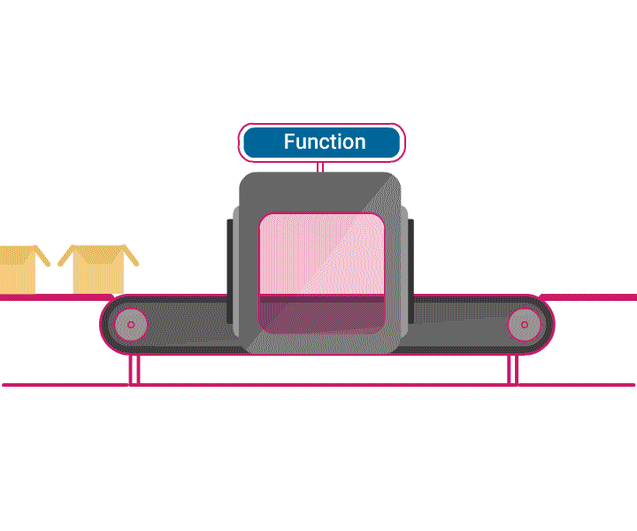
Functions
A function is a block of organised ,reusable code that is used to perform single, related action .
Functions provide better modularity for the applications.
There are two kinds of functions in Python -
Built-in functions that are provided as part of Python - raw_input(), type(), float(), int()...
Functions that we define ourselves and then use

Slide 14
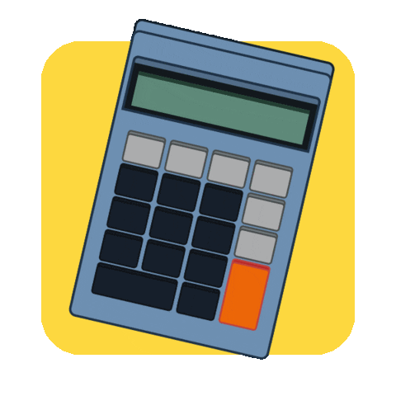
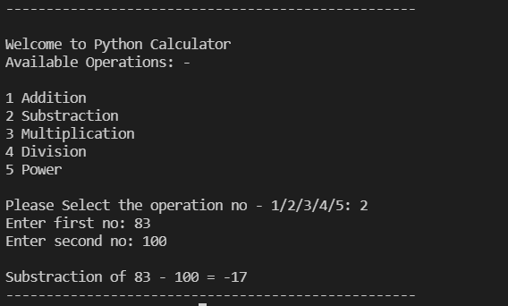
Python Calculator
Concepts used:
Inputs & Outputs
Conditional statements
Loops
Exception Handling

Slide 15
Any Questions?

Slide 16


